Slide 1
Health Screening &
Vaccination Programme
Dr Paula Cornally
Undergraduate Orientation Day | Wed 3rd September 2025
Notes:
Hello My Name is and I work…..
If there is one piece of advice I can offer to you all starting your nursing and midwifery careers to-day is that you need to look after yourself first before you can help others! And one of the first ways of doing that is to avail of the free vaccines available from the Occupational Health Departments attached to the Hospitals and Communities in which you live and work.

Slide 2

Q. Why is vaccination necessary?
For protection of yourself and others while working in a healthcare environment.
Undergraduate Orientation |
Notes:
It is important to protect yourself before coming into contact with patients in hospital or community setting as there is a risk you can be exposed to infection.
Similarly it is important that healthcare staff are vaccinated and screened to help prevent cross infection from healthcare workers to unwell patients particularly the very young and very old who are most vulnerable.

Slide 3
FACT:
Vaccination is the most effective strategy for prevention of Hepatitis B Viral (HBV) infection.
World Health Organisation
(WHO, 2016).
Undergraduate Orientation |
Notes:
The WHO have reported that the HB vaccine is 95% effective in preventing chronic liver infection caused by HBV.
So it makes sense to get the vaccine and have confidence that you are protecting yourself from any risk of acquiring the infection from your place of work.

Slide 4
Q. Where can I find more information?
To help you make an informed decision about the value of vaccination you will receive information directly from the experts in the Occupational Health Department during your first appointment there.
Information on Hepatitis B available from the Centre for Disease Control & Prevention (2021). Available at : Hepatitis B Vaccination | CDC
(Accessed 01 September 2023)
Undergraduate Orientation |

Slide 5
The Health Screening Programme
Q. What’s Offered?
You have been asked to provide the hospitals’ Occupational Health Dept with evidence of your BCG status
On your first Occupational Health appointment for Hepatitis B vaccination, you will be advised if any further follow-up is required regarding BCG status
Undergraduate Orientation |

Slide 6
Vaccination Programme includes:
Programme of Hepatitis B Vaccination
X 3 doses
(1st dose soon, 2nd dose approx. one month later & 3rd dose approx. 5-6 months after the first dose)
Post Hepatitis B Titres
(to check response levels)
Test to establish presence or absence of Immunity to TB
Undergraduate Orientation |

Slide 7
Blood tests to establish presence or absence of Immunity to:
    Measles
    Mumps
    Rubella
    Varicella (chickenpox)
    NB: C&G and Midwifery students - Pertussis
Undergraduate Orientation |

Slide 8
Q. Where do the free vaccinations take place?
With personnel in the hospitals Occupational Health Dept.
While Vaccination Programmes may differ slightly between Occupational Health Departments, they broadly offer the same vaccination & screening
Undergraduate Orientation |
Notes:
ALL Vaccinations are highly recommended as they protect both the student and the patients and staff the students come into contact
with during clinical placements.

Slide 9
Please Note
MRSA Screening is done later in Stages 2 & 3 of the Programme, prior to placements in hospitals that require it (NMH, CHI at Crumlin, Sports Clinic in Santry)
It is highly recommended that ALL students participate in the vaccination & screening programme
Undergraduate Orientation |

Slide 10
Q. How will Students know about appointments?
In Trimester 1, Sept to Dec 2025, all Occupational Health appointments are communicated to students from the Allocations Office via emails to your @ucdconnect.ie email account.
Thereafter Occupational Health appointments are communicated electronically to students through a system called ARC.
Undergraduate Orientation |

Slide 11
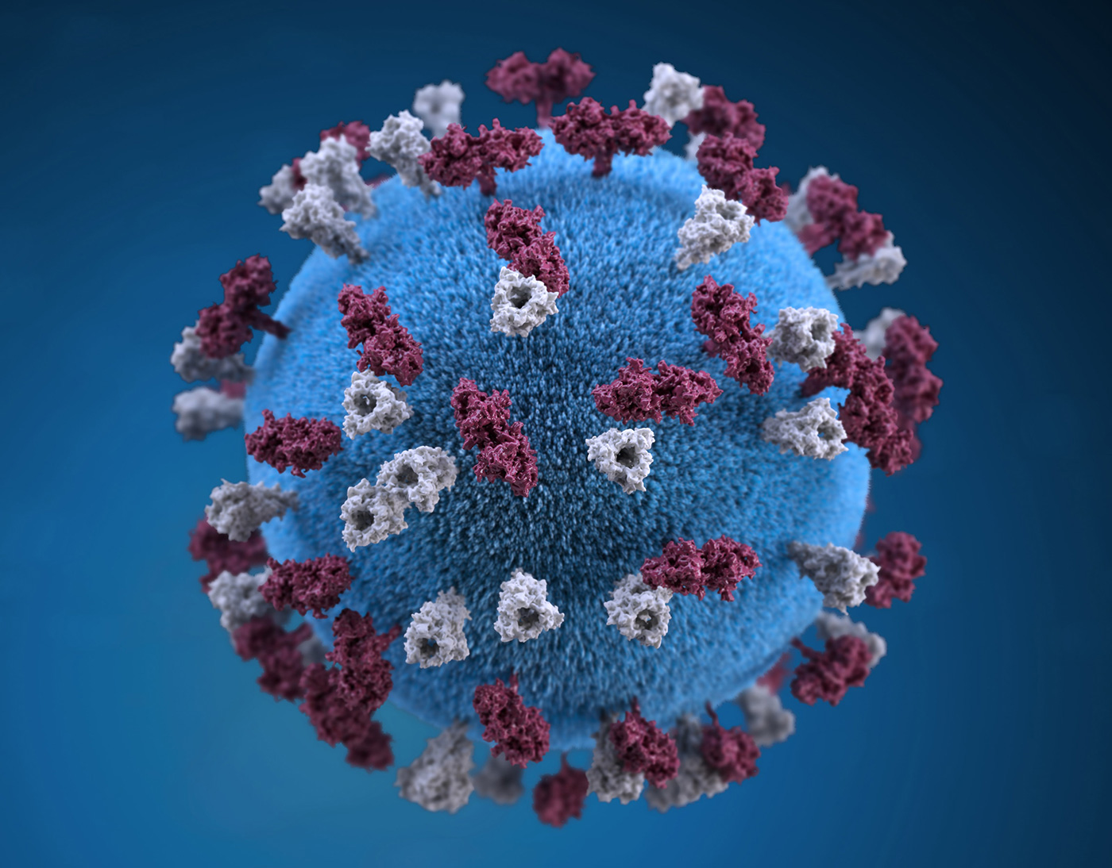
Coronavirus disease
(COVID-19)
Stay up to-date with reliable evidence
Coronavirus disease (COVID-19) (who.int)
https://www2.hse.ie/conditions/covid19/
(Accessed 01 September 2023)
This Photo by Unknown Author is licensed under CC BY-NC-ND
Notes:
The importance of this fact has never been more true in light of the pandemic. As Healthcare workers you will be expected to know and act upon best practice measures regarding all advise from the HSE and the WHO as it is the most scientific and factual.

Slide 12
Please Note
Covid 19 Vaccination is managed through the national process and as with all vaccines is highly recommended – especially for those in programmes related to Healthcare.
Please see HSE Immunisation website for
COVID-19 Vaccine Information for Health Professionals available at: COVID-19 Vaccine Information for Health Professionals - HSE.ie (Accessed 01 September 2023).
Undergraduate Orientation |

Slide 13

www.nmhs.ucd.ie/current-students
WHO: A global response to a global pandemic (1min 54secs)
https://youtu.be/yEIPefMsf70
Notes:
WHO 2016: 1.4 million people died from Hepatitis of which 47% were from HBV
The WHO aim to eradicate viral hepatitis and vaccination will be the main focus of achieving that goal.

